Slide 1
Retail Store Simulation
Project Presentation

Slide 2
Introduction and Description
This is a Retail Store Simulation. It shows customers entering the shop, choosing items from aisles and then going to cash out. It makes use of different data structures such as linked lists and stacks. It also makes use of algorithms to move customers and staff and to process different decisions made by the customer.

Slide 3
Objectives
The objective is to show the working of the whole shop using data structures and algorithms. Here are some of the issues:
Storing products/items on a shelf or in the basket.
Determining walking paths for the customer and the staff.
The whole shop itself is a linked list of customers which needs to be managed properly.

Slide 4
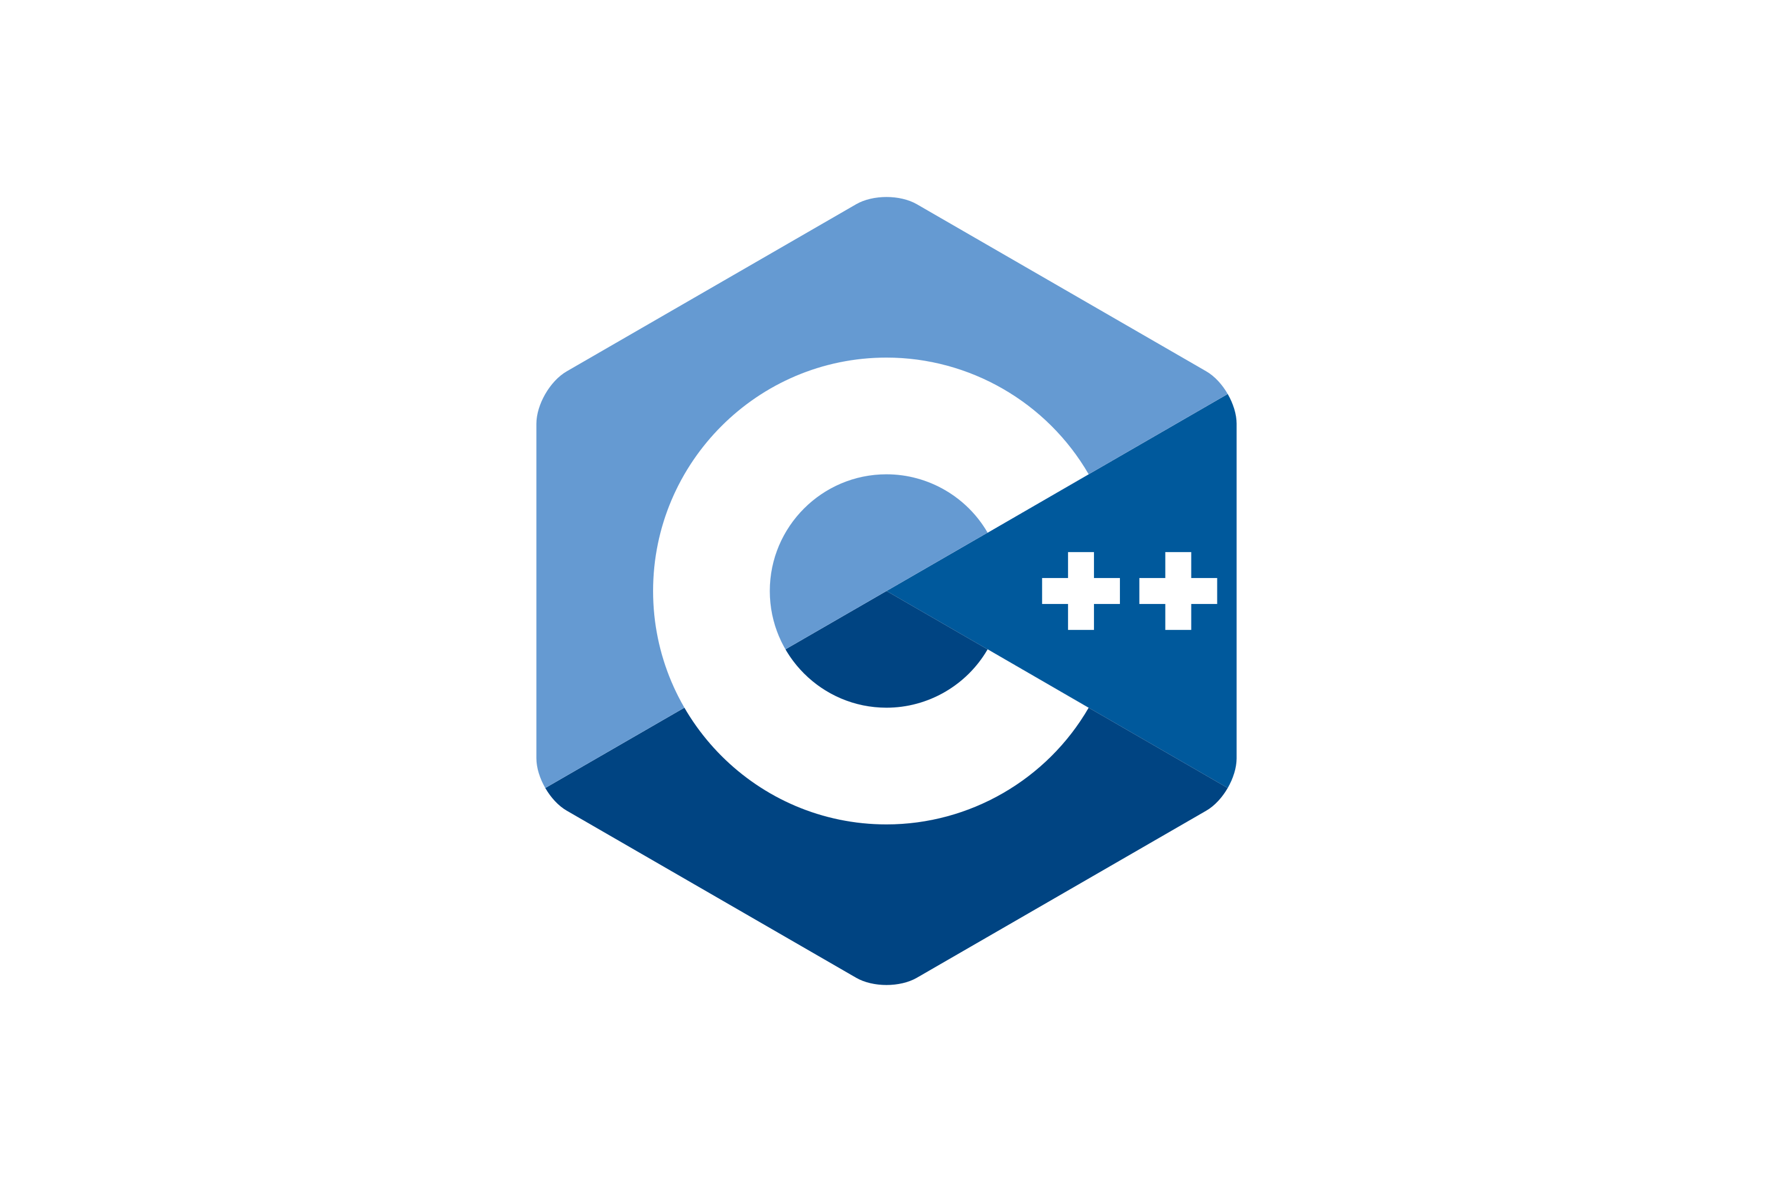


Language, libraries and IDE
The development environment used for this project is Visual Studio Community 2019.
The programming language used is C++.
Many libraries were used. For graphics, SFML libraries were used. This required linking of those libraries in order to be able to use them.

Slide 5
Language, libraries and IDE
SFML Libraries
Graphics.hpp
System.hpp
Window.hpp
Audio.hpp
Other Libraries
string.h
stdlib.h
time.h

Slide 6
Code, Algorithm and Output
The whole program adds up to 996 lines. So, it is not possible to add all the code. However, we will explain and analyze the important algorithms used.
The algorithms we will be looking at are:
Shopping Algorithm
Cash out Algorithm
Restocking Algorithm

Slide 7
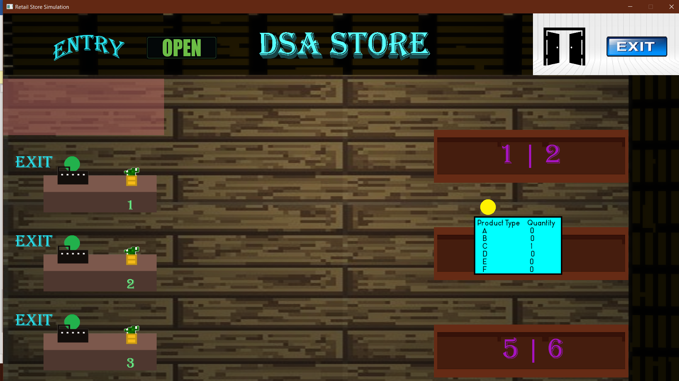
Code, Algorithm and Output
Shopping Algorithm
The customer needs to reach a key point. So,
the customer walks 0.6 steps/frame in the X
direction. The Big-O notation here will be
O(KeyPointX-CurrentPositionX).
isShopping variable needs to be true.
If shelf 1 or 2 are selected.

Slide 8
Code, Algorithm and Output
Shopping Algorithm
The customer will walk 0.6 steps/frame towards
the X direction.
Then it needs to put items in their basket. The
maximum amounts of items that a customer can
pick from the shelf at a time is 3.
Each item is picked after 3 seconds.
The customer moves back to the key point.

Slide 9
Code, Algorithm and Output
Shopping Algorithm
Customer generates randomly whether they want
to shop again or no.
If yes, the whole process is repeated again.
The Big-O notation in this scenario would be
something like this:
ShopAgain(O(DestinationX-CurrentPosX)*2 +
O(AmountofProducts*3)).

Slide 10
Code, Algorithm and Output
Shopping Algorithm
If shelf 3, 4, 5 or 6 are selected.
No difference except the Y movement.
This will change the Big-O notation slightly.
ShopAgain(O(DestinationY-CurrentPosY)*2 +
O(DestinationX-CurrentPosX)*2 +
O(AmountofProducts*3)).

Slide 11
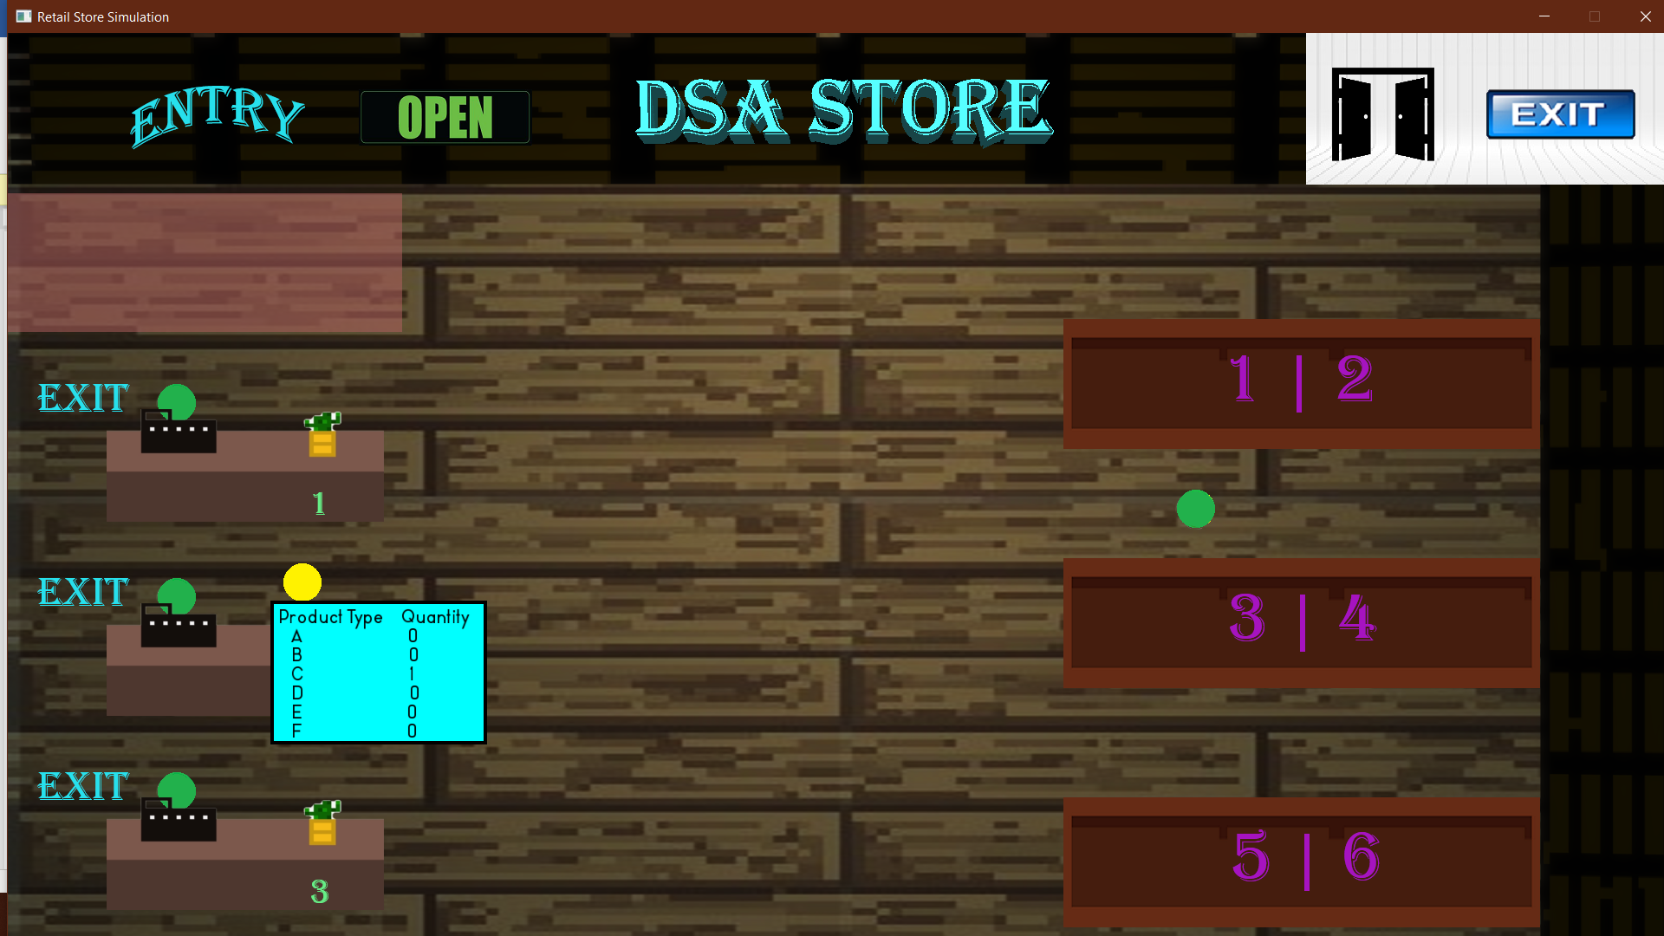
Code, Algorithm and Output
Cash out Algorithm
This algorithm is connected to the Shopping
Algorithm.
The cashing queue is decided in the Shopping
Algorithm.
Movement in the X and Y direction in order to
reach the desired queue.

Slide 12
Code, Algorithm and Output
Cash out Algorithm
In an alternate scenario, the queue could be
occupied, need to wait.
Maximum queue capacity is 4.
Takes 2 seconds to process a product.

Slide 13
Code, Algorithm and Output
Cash out Algorithm
Big-O notation where the customer is first in
line: O(DestinationY-CurrentPosY) +
O(DestinationX-CurrentPosX) +
O(ProductsinBasket)*2
Big-O notation where the customer has to wait:
O(Z)*1,2,3 + O(Z),
where Z = The 1st notation

Slide 14
Code, Algorithm and Output
Restocking Algorithm
Each aisle has 2 shelves. They are marked with
numbers.
Algorithm monitors the 2 shelves in an aisle.
Big-O notation: O(n).
If the quantity of products fall to 4 or below,
algorithm triggers.

Slide 15
Code, Algorithm and Output
Restocking Algorithm
Staff walks in X and Y direction to reach the
desired shelf to restock.
Keeps restocking till the shelf is full.
Takes 2 seconds to restock one item.
Once done restocking, walks back from where
it came from.

Slide 16
Code, Algorithm and Output
Restocking Algorithm
Big-O notation:
O(DestinationY-CurrentPosY)*2 +
O(DestinationX-CurrentPosX)*2 + O(12).
Since there are approx. 6 products to restock
and it takes 2 seconds/product to restock,
so, 6*2 = 12.

Slide 17
Code, Algorithm and Output
Other necessary functions
void CreateCustomer() from Shop.h – this is used to add customer to the linked list of the shop.
void DeleteCustomer() from Shop.h – this is used to remove customer from the linked list of the shop.
void DetectCustomer() and void DetectAisle() from Shop.h – these two functions are used to display the quantity of products when the user hovers over the shelves or a customer.
bool doShopping() from Customer.h – this function is used to transfer items from the shelf to the basket.

Slide 18
Code, Algorithm and Output
Other necessary functions
void CheckLine() from Customer.h – this function is used to determine which queue to go to when going for cashing out.
Product RemoveFromStack() from Aisle.h – this function removes the items from the shelf when the customer shops.
void PutInBasket() from BasketOfCustomer.h – this function puts the items in the customer’s shopping basket.
Product RemoveFromBasket() from BasketOfCustomer.h – this function removes products from a customer’s basket at cash out.

Slide 19
Conclusion
The program makes use of data structures and algorithms efficiently. The data structures are used to store customers in the shop in the form of linked lists, the basket of a customer is a linked list, the item shelves are stacks and the cashier counters are queues. The algorithms ensure the smooth flow of the simulation without consuming much time and resources. All the objectives have been fulfilled.

Slide 20
Retail Store Simulation
Project by:
M.Talal Farrukh – 321881
M.Salman Shaheer – 283669

